Slide 1

2020 Graduate Project Third Presentation
Blottery
After-used electric car battery management System with BlockChain
201533661 이승수
201533662 이원창
201635805 김서윤

Slide 2

INDEX

Slide 3
01
Why we need After-Used Battery Management System?
2nd users
1st users
Need After-Used battery treatment facilities.

Slide 4
01
Why we need After-Used Battery Management System?
Percentage of Manufacturing
Li-ion Battery
70~80% capacity of after-used battery is still available.
Can be recycled to create economic value.

Slide 5
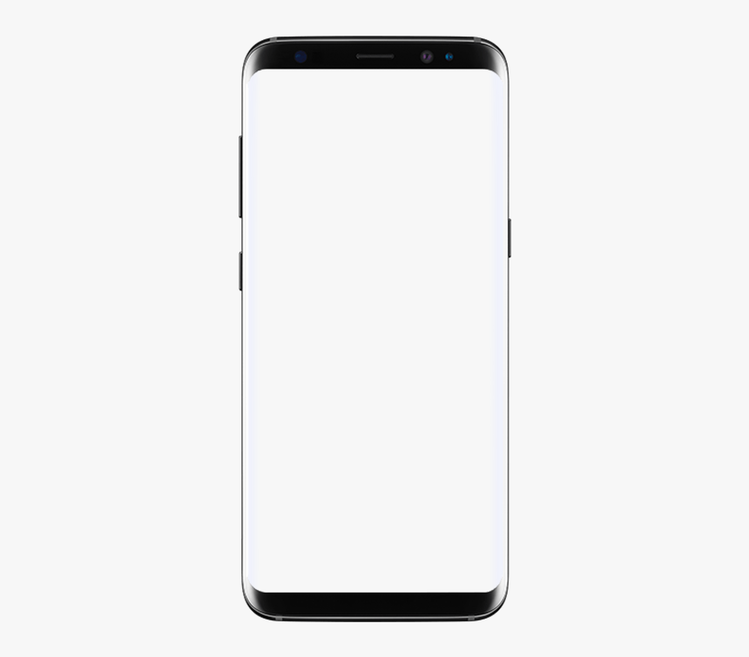
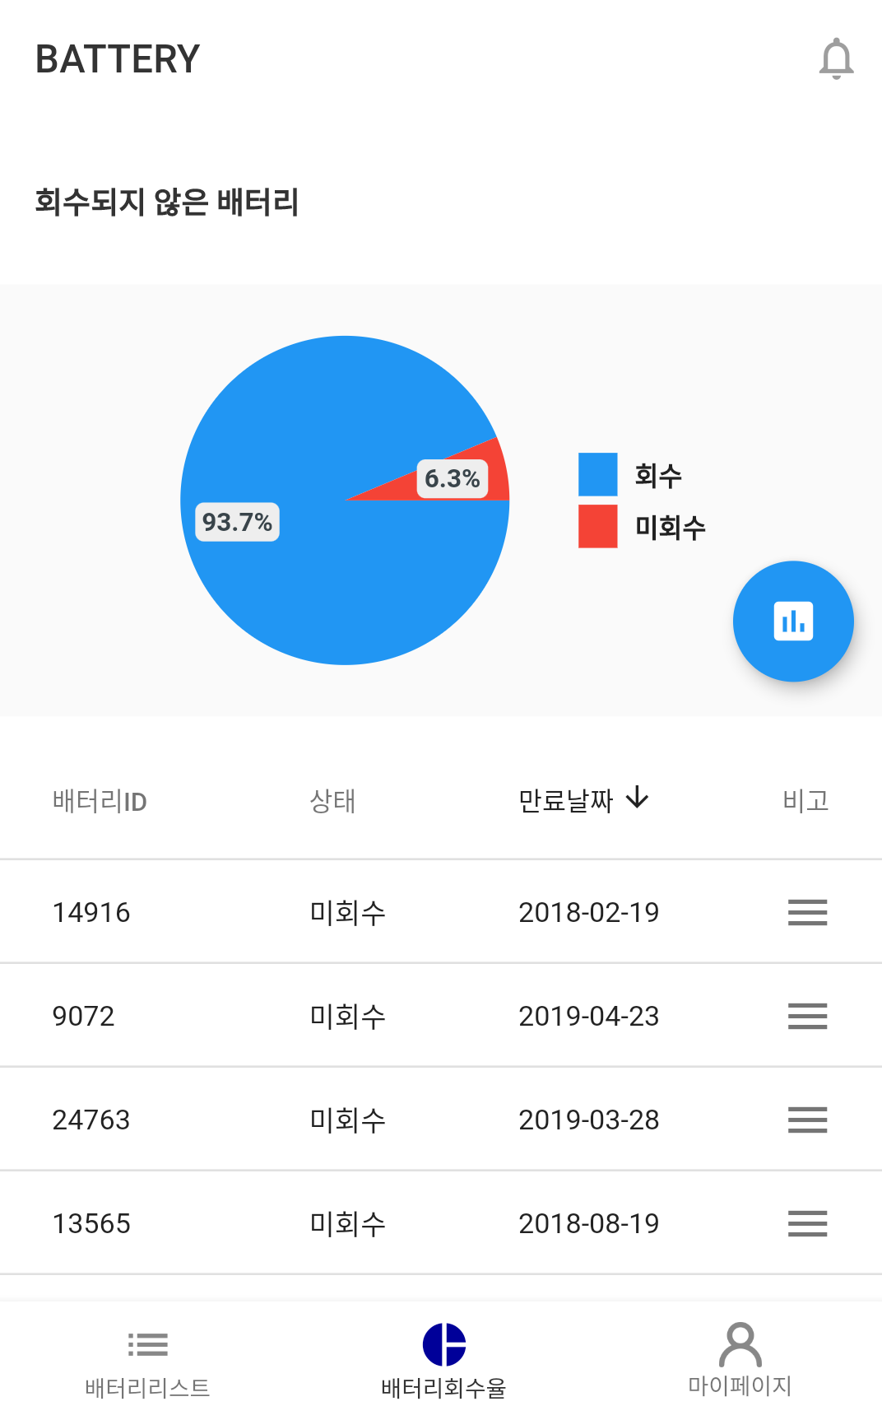
02
Introduction
Blottery
After-used electric car battery management System with BlockChain
Blottery = Blockchain + Battery

Slide 6
02
Introduction
Current Electric Car Battery Management System - Battery Recycling Tasks
1
There is no normalized after-used Battery management/certificate system
to evaluate value of After-used Battery Pack.
2
Need Battery Pack Management System
for Transparency, flow history management, and battery distribution monitoring.

Slide 7



02
Introduction
Necessity
Irreversibility, Reliability
History tracking
Anti-fabrication
Need to improve distribution safety when distributing ESS (Energy Storage System) products.
When an accident is issued, accurate tracking of the distribution channels in a short period of time.
Battery test report and product certificate of supplied ESS need to be prevented from forgery and alteration.

Slide 8
02
Introduction
Expectation
1
2
3
ECONOMIC
INDUSTRIAL
SOCIAL
Securing convenience and reliability of public services
Establishing a resource circulation system and management plan for electric vehicle battery processing
Expecting employment effects of about 200 people in the province related to electric vehicle batteries
Distributing more economical reuse ESS.
Standardization of waste battery reuse process
Improving transparency in tracking distributio
Contributing to reduce the cost of ESS introduction
Reuse module sales revenue expected to increase

Slide 9


02
Introduction
Target
Administrators for After-used Battery
ex) Gov.branch employee, Recycling Center administrators, etc..
Electric Car users

Slide 10
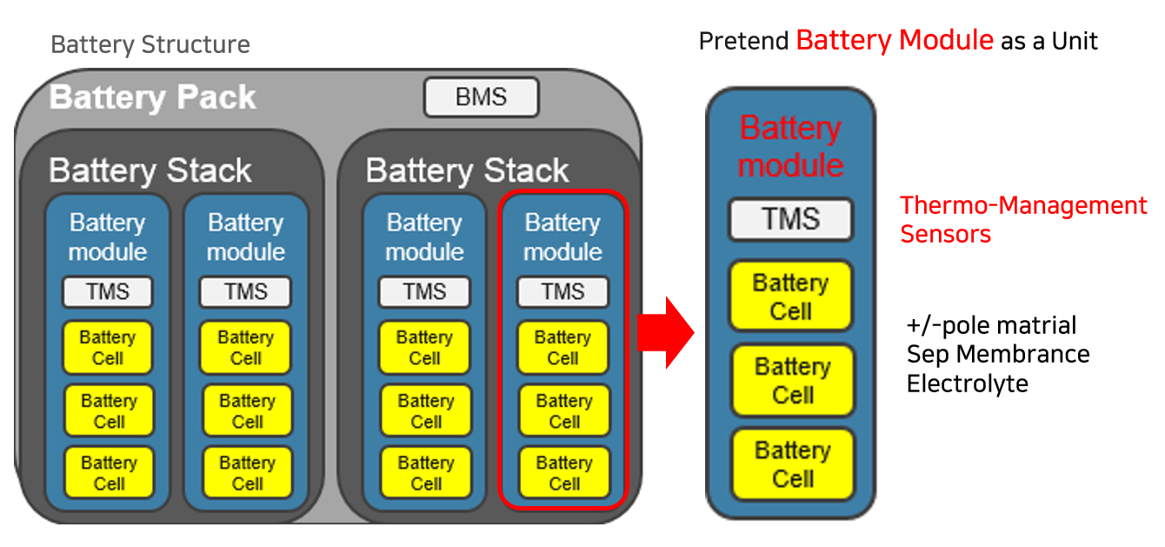
02
Introduction
Basic Battery Unit = Battery Module
We will manage battery module as a unit

Slide 11
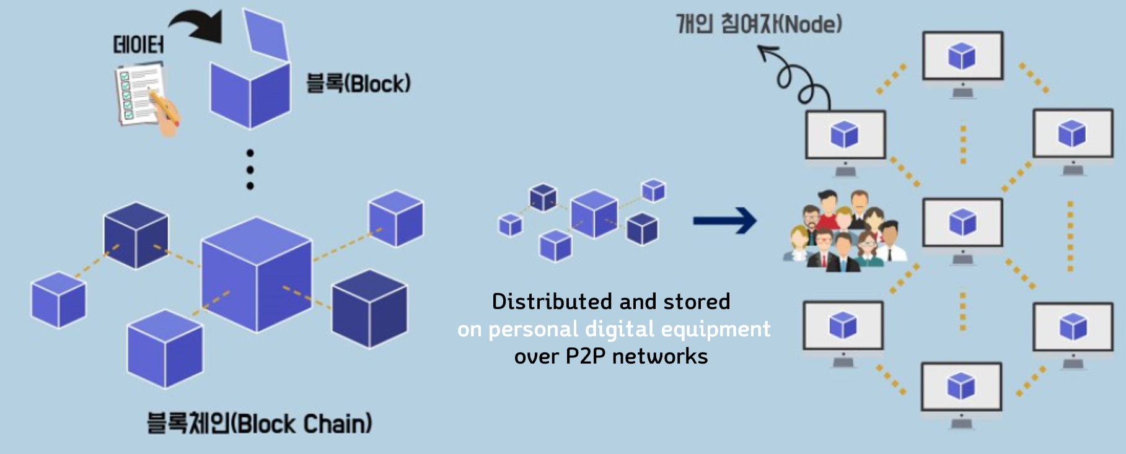
03
Background
BlockChain?
“Distributed data storage technology” that stores data in blocks and links it in a chain,
replicating it to numerous computers at the same time."

Slide 12


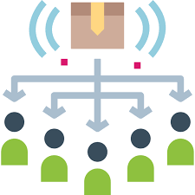
03
Background
BlockChain!
Not a centralized server
→ Transaction details are
sent to all users
All participants share
→ Cannot be forged
or tampered with
Data distribution
→ Data safety and reliability

Slide 13







04
Implementation
Specs of Project
Language
Cryptocurrency
DB
Ethereum tool
Mobile
METAMASK

Slide 14
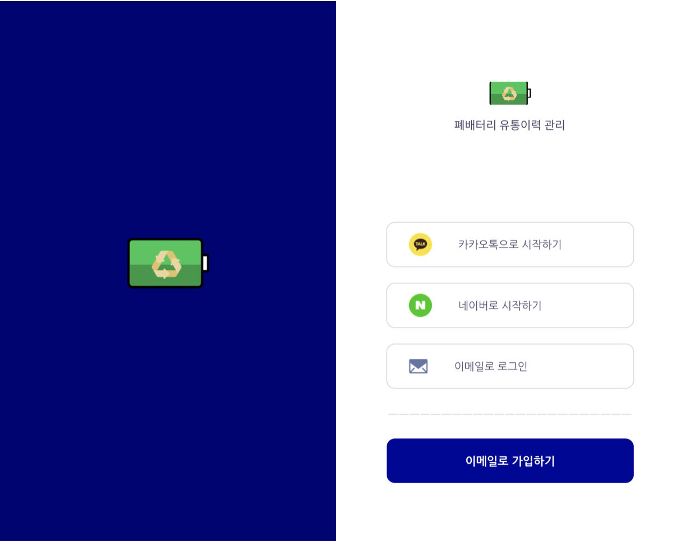
04
Implementation
Splash & Login Screen
Users can select type of login (KakaoTalk, Naver or E – mail)
Login type (KakaoTalk, Naver) uses their login api
Login type (E – mail) uses our own server

Slide 15
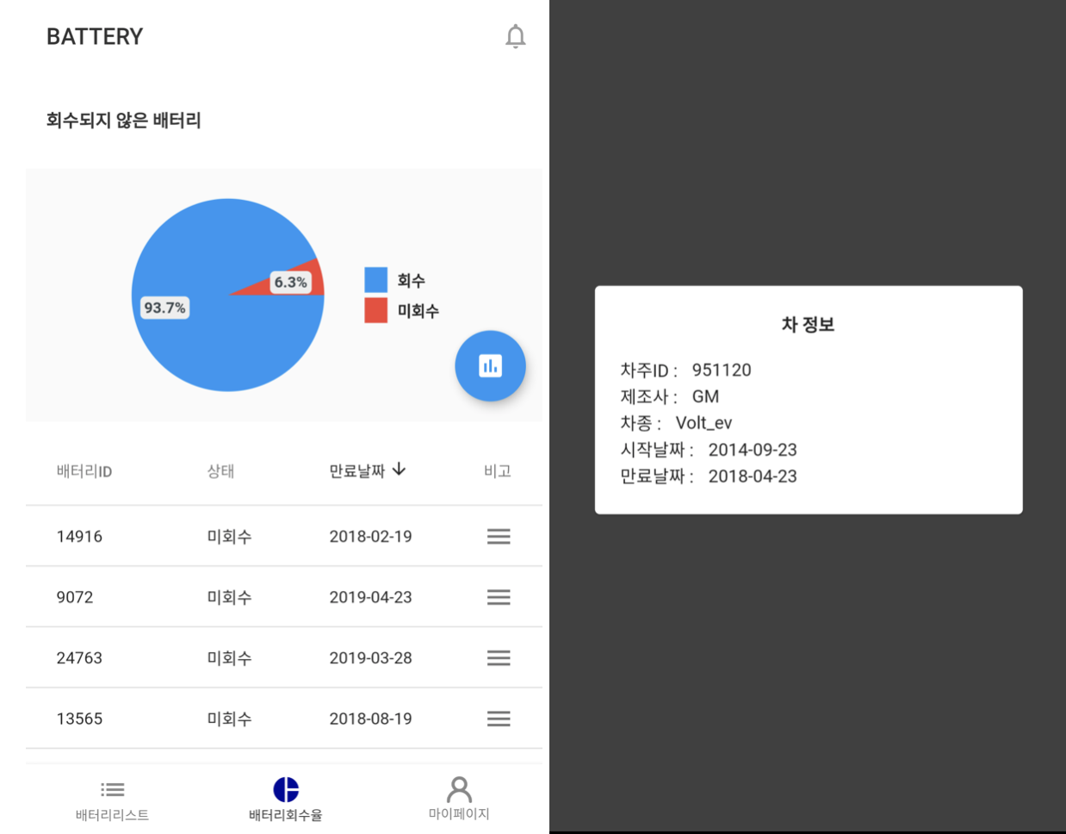
04
Implementation
Main Screen
2 – 1. Recycling Rate Monitoring screen
You can monitor recycling rate in real time Next, You can see the battery recycling rate at main page.
You can select one of three page buttons at bottom.(Battery List, Recycling Rate, My Page)
At 'Recycling Rate' page, you can monitor battery
information
When you click one of battery slot at main page, you can look at detailed information about each
batteries.

Slide 16
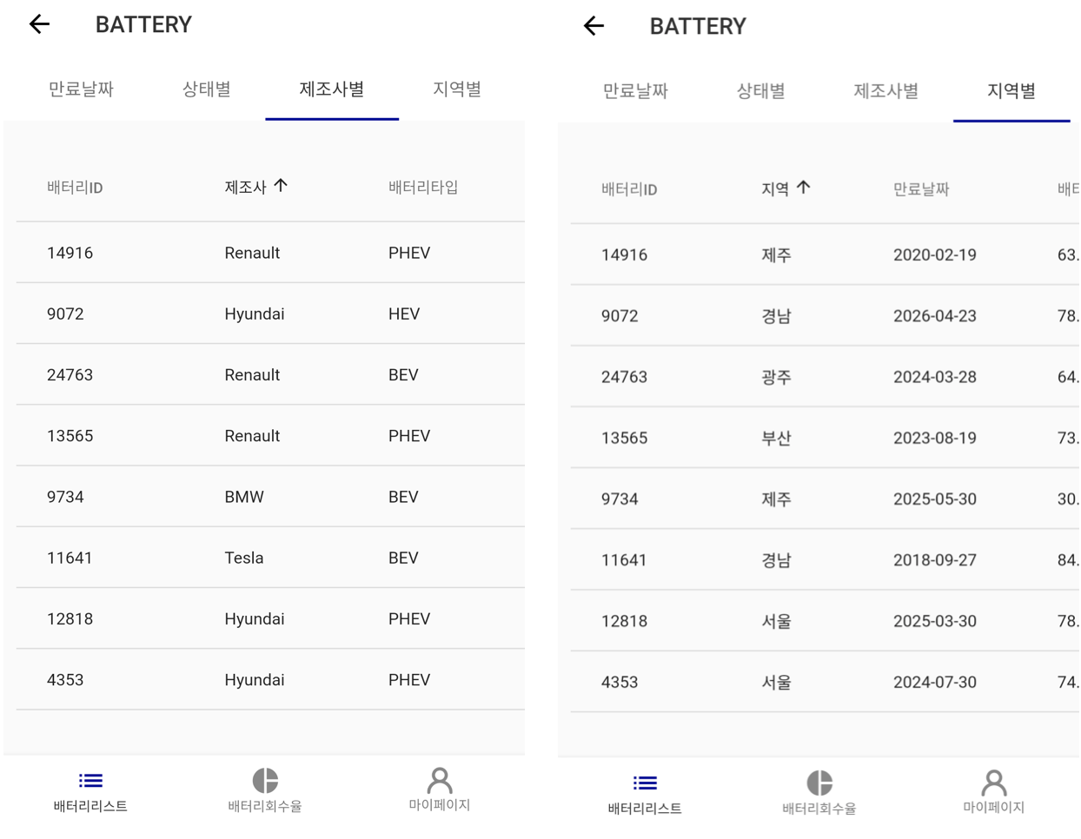
04
Implementation
Main Screen
2 – 2. Battery List
Battery List: view information
(Expire date, state, manufacturer, location, etc.)
Each battery contains expire date, state,
manufacturer, location, etc.
Lists of batteries sorted by selected criteria

Slide 17
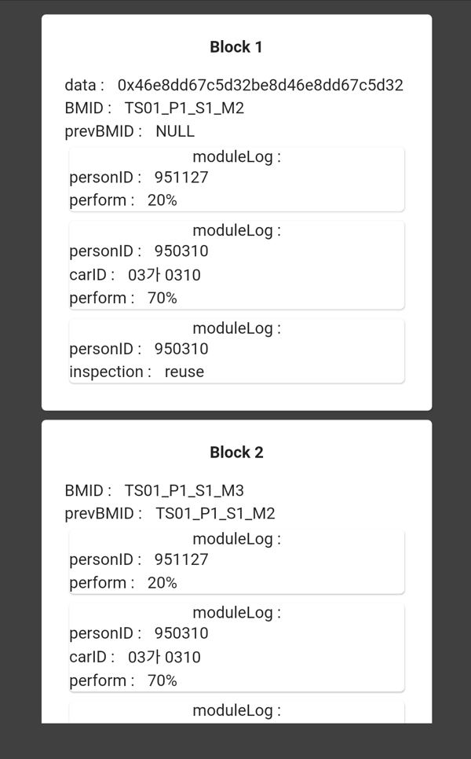
04
Implementation
Main Screen
2 – 3. Detail History of each Battery
You can look at selected battery's recycling history when click one of battery list want to look up.

Slide 18
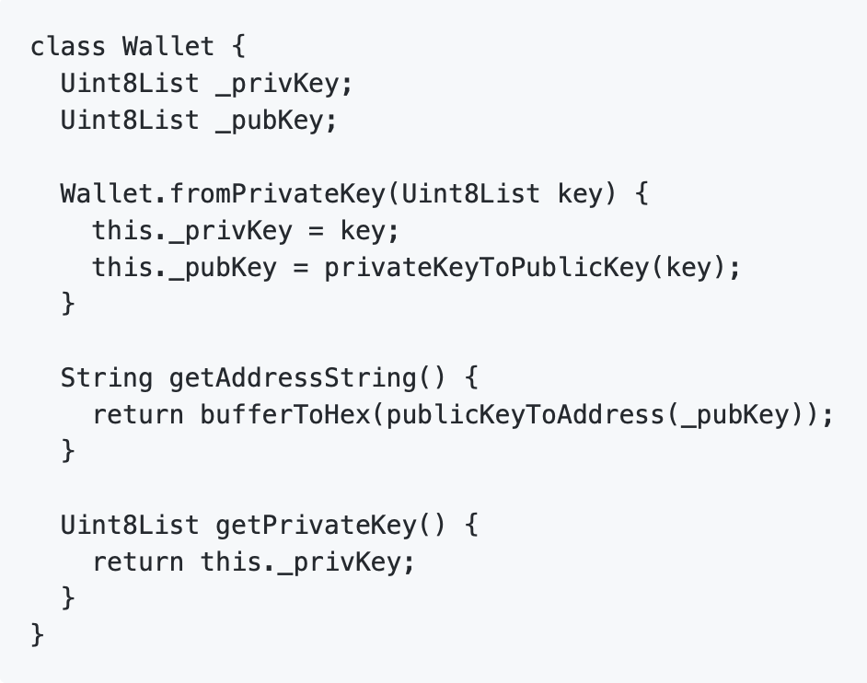
04
Implementation – Sample Code
Create Wallet

Slide 19
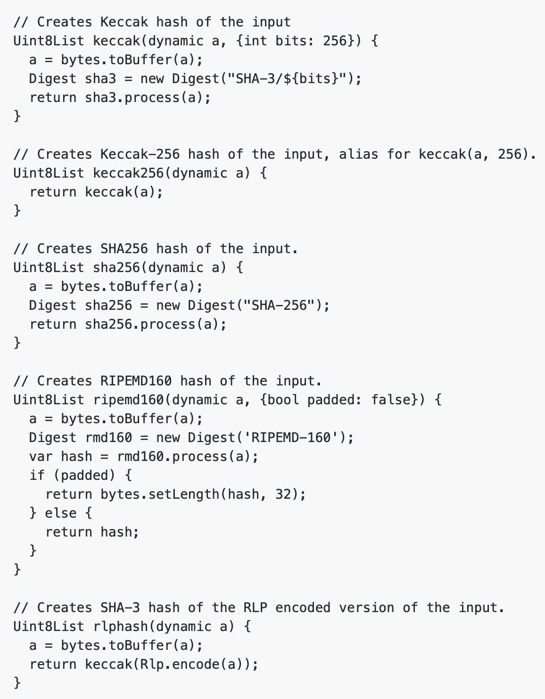
04
Implementation – Sample Code
Create Hash

Slide 20


05
Marketing Plan
Car Insurance Company
Give:
Sell domestic Electric-Car Driving data/statistics
by each models
Electric Car users
Battery Recycling Center
Give:
- Battery exchange cost benefit.
- Cost benefit for Joined Insurance services
- Driving habit coaching service for battery-life improvement.
Take:
- Gather driving&battery data
Give:
- Provide Electric-Car Battery History
Take:
- Battery exchange benefits to App users.
Notes:
저희 조의 마케팅 플랜은 전기차사용자, 재활용센터, 차보험사 이렇게 세가지를 묶는 방안을 생각해봤습니다.
먼저 재활용 센터와는
- 센터에 전기차 모델 별 실시간 배터리 상태, 주행성능 등의 데이터와 통계를 제공합니다.
앱 사용자에게는 배터리 교체 시 지원금이나 무료점검 등의 혜택을 지원 약속받습니다.
보험사의 경우에는,
보험사에 누적된 사용자들의 전기차 모델별 안전성 관련 주행 데이터를 판매합니다.
앱 사용자에게는,
- 주행 데이터와 실시간 배터리 상태 정보 등을 테슬라 API를 이용해 받아옵니다.
- 재활용 센터와 연게해 배터리교체 비용을 일부 지원하고,
보험사와 연계해 보험사 홍보 차원의 연관 보험상품 가입 시 할인혜택 등을 제공합니다.
- 또한 효율적 배터리 사용을 위한 운전습관 개선 코칭 서비스를 제공합니다.

Slide 21



06
Member
Lee seung-soo
Architecture design
Back end (firebase)
wlstjd56@gmail.com
Lee won-chang
Back end (solidity smart contract)
Front end (flutter)
dnjs7651@gmail.com
Kim seo-yoon
Front end (flutter)
Connection between front end and back end
pkhssyun@gmail.com

Slide 22

07
Wiki Link
https://github.com/teddy309/Blottery/wiki

Slide 23
2020 Graduate Project Third Presentation
THANK YOU

